Slide 1
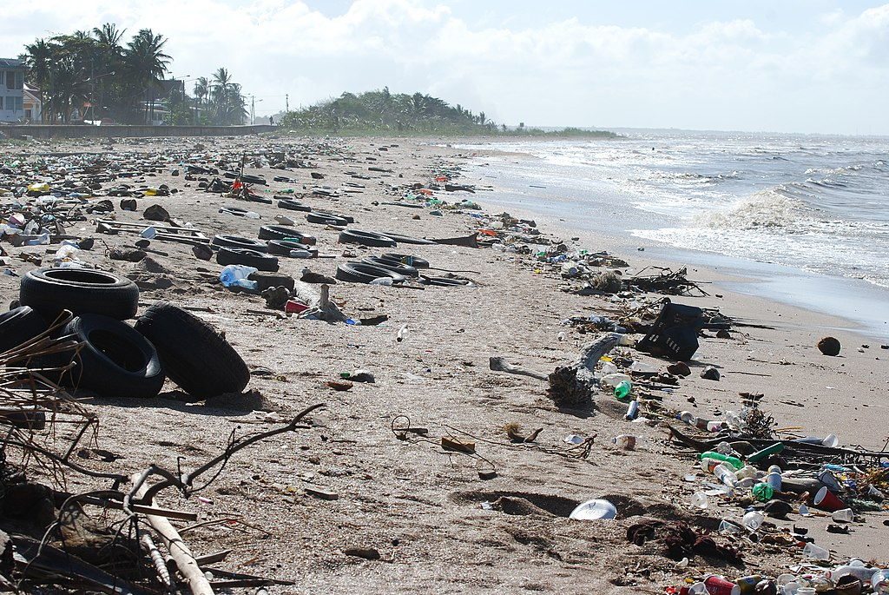
POLLUTION
Pollution is the introduction of contaminants into the natural environment that cause adverse change. Pollution can take the form of any substance (solid, liquid, or gas) or energy (such as radioactivity, heat, sound, or light). Pollutants, the components of pollution, can be either foreign substances/energies or naturally occurring contaminants.
Although environmental pollution can be caused by natural events, the word pollution generally implies that the contaminants have an anthropogenic source – that is, a source created by human activities, such as manufacturing, extractive industries, poor waste management, transportation or agriculture. Pollution is often classed as point source (coming from a highly concentrated specific site, such as a factory, mine, construction site), or nonpoint source pollution coming from a widespread distributed sources, such as microplastics or agricultural runoff.

Slide 2
Types of Pollution
Water Pollution
Air Pollution
Noise Pollution
Light pollution
Plastic pollution

Slide 3
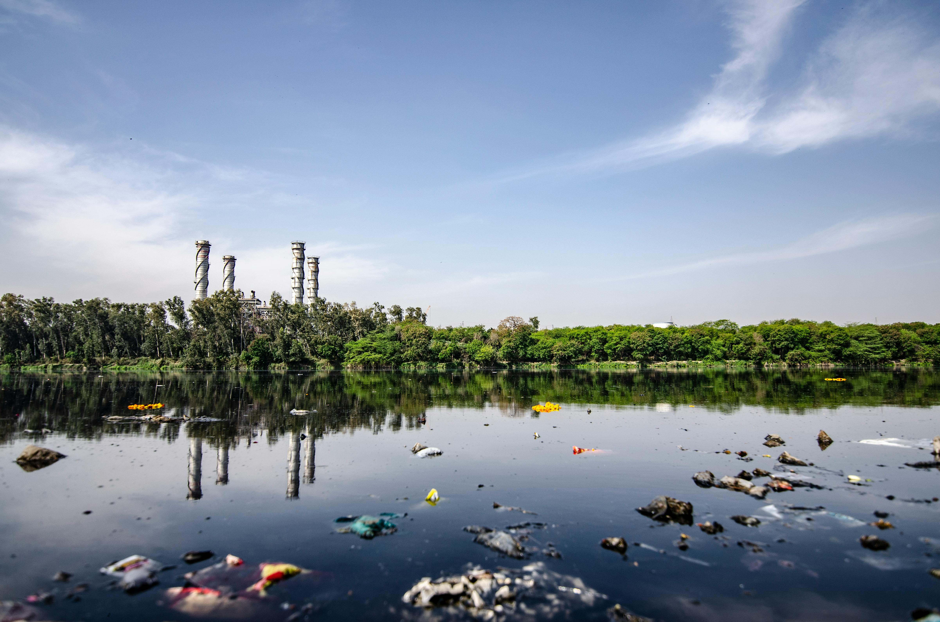
Water Pollution
Water pollution, caused by the discharge of industrial wastewater from commercial and industrial waste (intentionally or through spills) into surface waters; discharges of untreated sewage and chemical contaminants, such as chlorine, from treated sewage; and releases of waste and contaminants into surface runoff flowing to surface waters (including urban runoff and agricultural runoff, which may contain chemical fertilizers and pesticides, as well as human feces from open defecation).

Slide 4
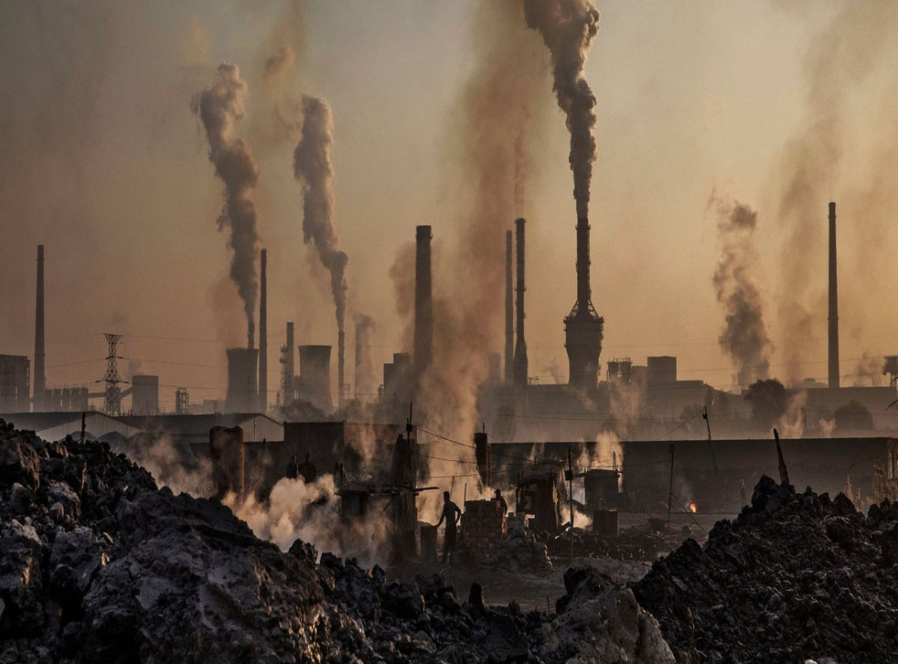
Air Pollution
Air pollution the release of chemicals and particulates into the atmosphere. Common gaseous pollutants include carbon monoxide, sulfur dioxide, chlorofluorocarbons (CFCs) and nitrogen oxides produced by industry and motor vehicles. Photochemical ozone and smog are created as nitrogen oxides and hydrocarbons react to sunlight.

Slide 5
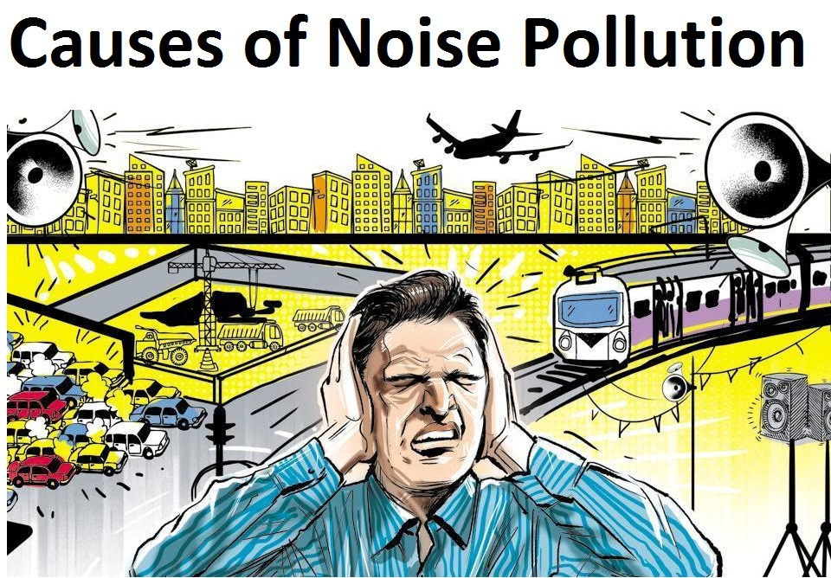
Noise Pollution
Noise pollution, or sound pollution, is the propagation of noise or sound with ranging impacts on the activity of human or animal life, most of which are harmful to a degree. The source of outdoor noise worldwide is mainly caused by machines, transport and propagation systems. Poor urban planning may give rise to noise disintegration or pollution, side-by-side industrial and residential buildings can result in noise pollution in the residential areas. Some of the main sources of noise in residential areas include loud music, transportation (traffic, rail, airplanes, etc.) lawn care maintenance, construction, electrical generators, wind turbines, explosions and people.

Slide 6
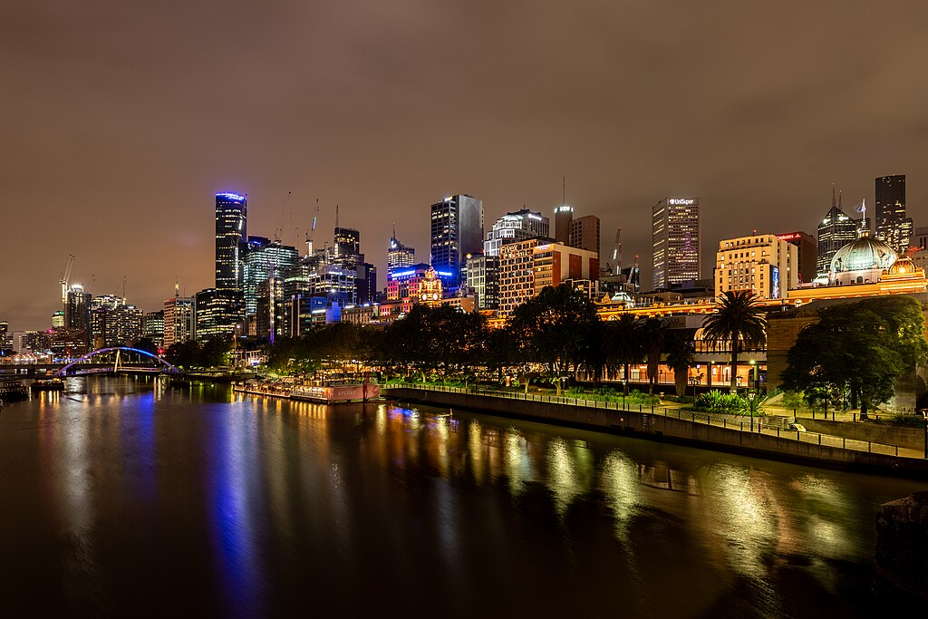
LIGHT POLLUTION
Light pollution is the presence of any unwanted, inappropriate, or excessive artificial lighting. In a descriptive sense, the term light pollution refers to the effects of any poorly implemented lighting sources, during the day or night. Light pollution can be understood not only as a phenomenon resulting from a specific source or kind of pollution, but also as a contributor to the wider, collective impact of various sources of pollution.

Slide 7
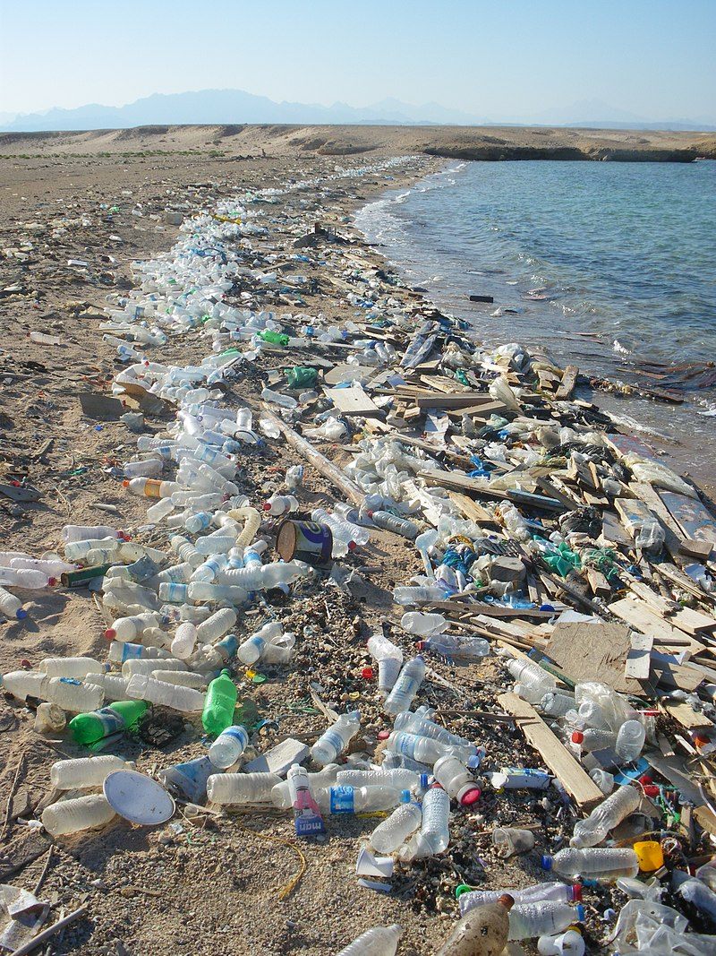
PLASTIC POLLUTION
Plastic pollution is the accumulation of plastic objects and particles (e.g. plastic bottles, bags and microbeads) in the Earth's environment that adversely affects humans, wildlife and their habitat. Plastics that act as pollutants are categorized by size into micro-, meso-, or macro debris. Plastics are inexpensive and durable, making them very adaptable for different uses; as a result, manufacturers choose to use plastic over other materials. However, the chemical structure of most plastics renders them resistant to many natural processes of degradation and as a result they are slow to degrade. Together, these two factors allow large volumes of plastic to enter the environment as mismanaged waste which persists in the ecosystem and travels throughout food webs.
Plastic pollution can afflict land, waterways and oceans. It is estimated that 1.1 to 8.8 million tones of plastic waste enters the ocean from coastal communities each year. It is estimated that there is a stock of 86 million tons of plastic marine debris in the worldwide ocean as of the end of 2013, with an assumption that 1.4% of global plastics produced from 1950 to 2013 has entered the ocean and has accumulated there.

Slide 8
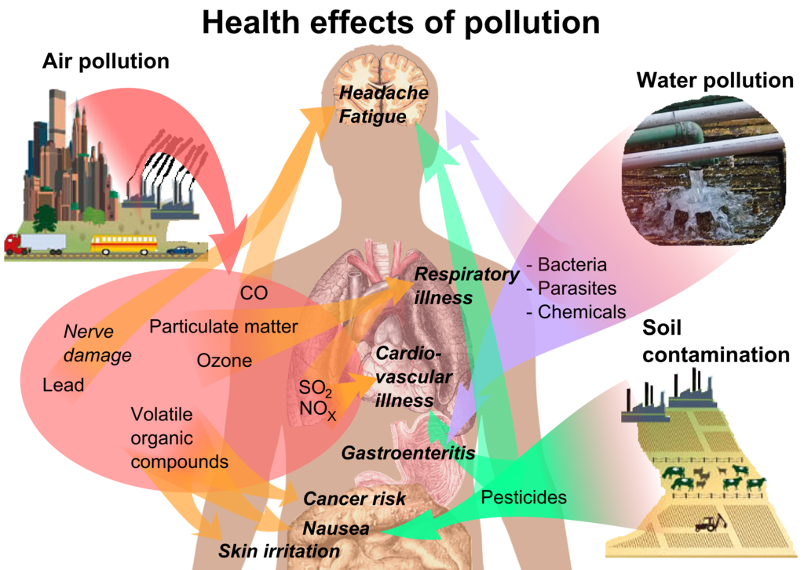
EFFECTS OF POLLUTION
Pollution affects humans in every part of the world. An October 2017 study by the Lancet Commission on Pollution and Health found that global pollution, specifically toxic air, water, soil and workplaces, kills nine million people annually, which is triple the number of deaths caused by AIDS, tuberculosis and malaria combined, and 15 times higher than deaths caused by wars and other forms of human violence. The study concluded that "pollution is one of the great existential challenges of the Anthropocene era. Pollution endangers the stability of the Earth's support systems and threatens the continuing survival of human societies.
Adverse air quality can kill many organisms, including humans. Ozone pollution can cause respiratory disease, cardiovascular disease, throat inflammation, chest pain, and congestion. A 2010 analysis estimated that 1.2 million people died prematurely each year in China alone because of air pollution. China's high smog levels can damage the human body and cause various diseases. In 2019, air pollution caused 1.67 million deaths in India (17.8% of total deaths nationally).Studies have estimated that the number of people killed annually in the United States could be over 50,000.A study published in 2022 in Geohealth concluded that energy-related fossil fuel emissions in the United States cause 46,900–59,400 premature deaths each year and PM2.5-related illness and death costs the nation $537–$678 billion annually. In the US, deaths caused by coal pollution were highest in 1999, but decreased sharply after 2007. The number dropped by about 95% by 2020, as coal plants have been closed or have scrubbers installed.
Those with heart or lung disorders are at additional risk. Children and infants are also at serious risk. Lead and other heavy metals have been shown to cause neurological problems, intellectual disabilities and behavioural problems. Chemical and radioactive substances can cause cancer and birth defects.

